Slide 1
The Cloud
Eoin Carroll

Slide 2
What is the cloud?
Notes:
Not a web server
Not a file server
Something in between
Multi functional
IAAS == VM
PAAS == websites, cloud services, web apps.
SAAS

Slide 3
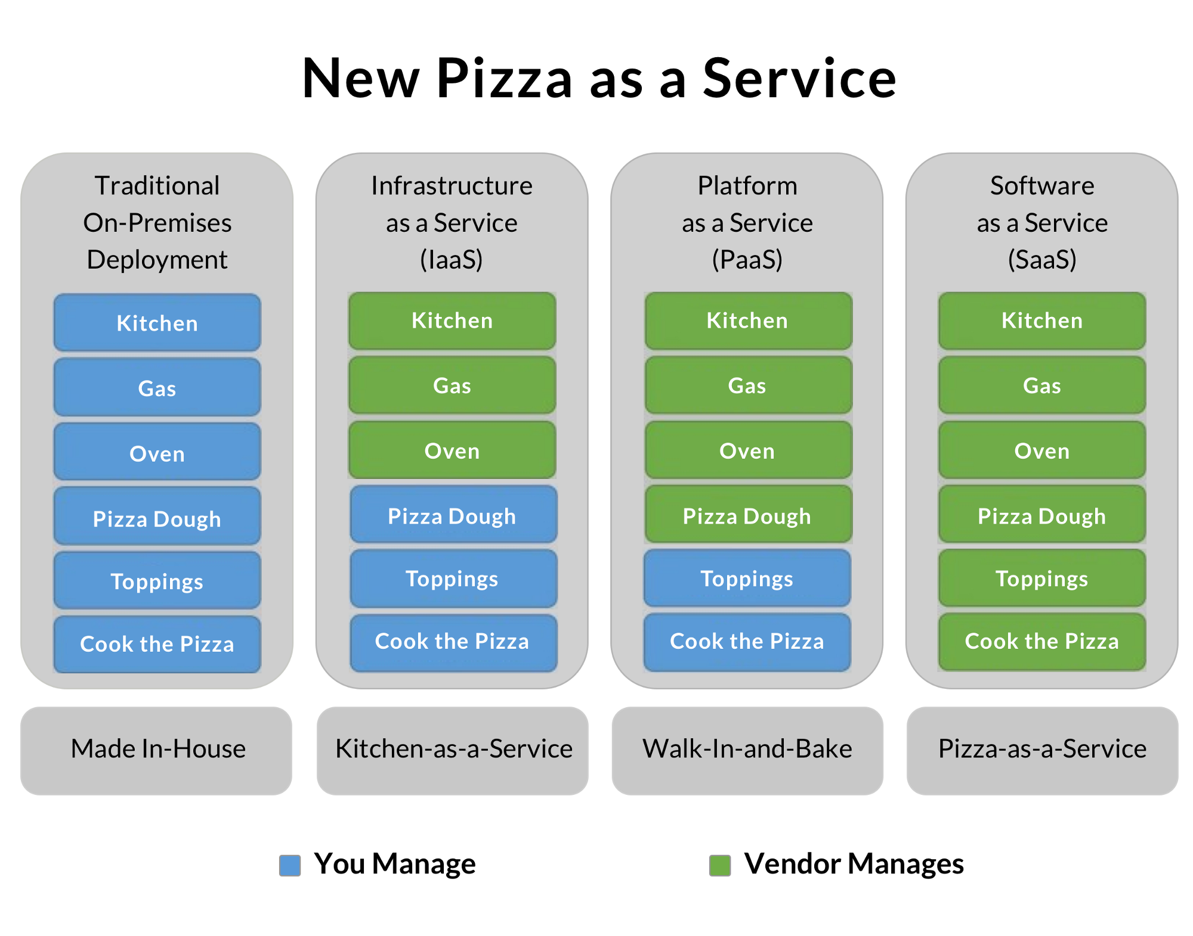
Notes:
Put pizza as a service on this slide.

Slide 4
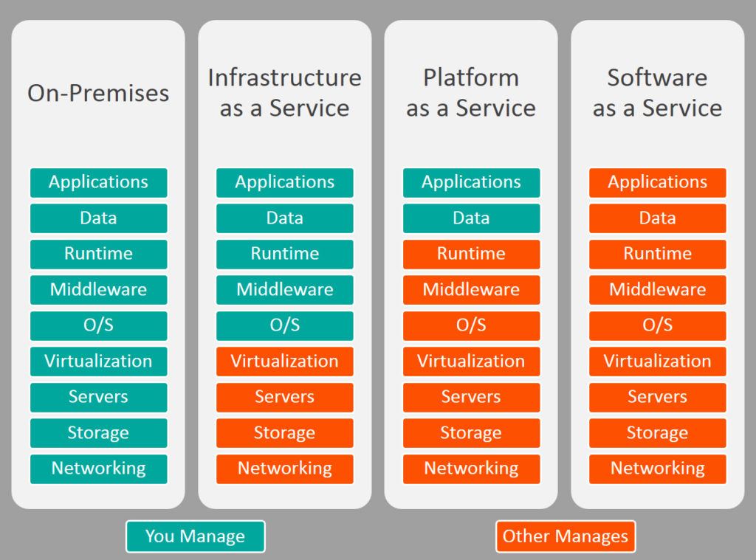
Notes:
Put pizza as a service on this slide.

Slide 5
Why the cloud?

Slide 6
Why the cloud?
Rapidly setup environments to drive business priorities
Scale to meet peak demands
Increase daily activities, efficiency and reduced cost.
Speed
Scale
Economics

Slide 7
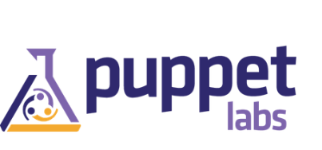



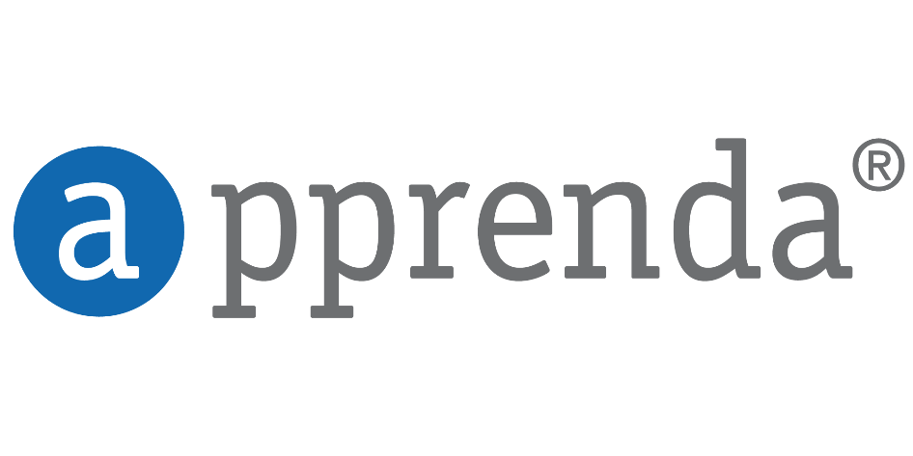



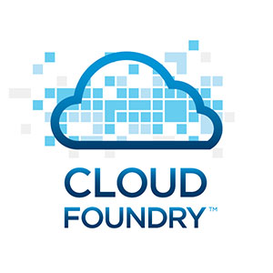











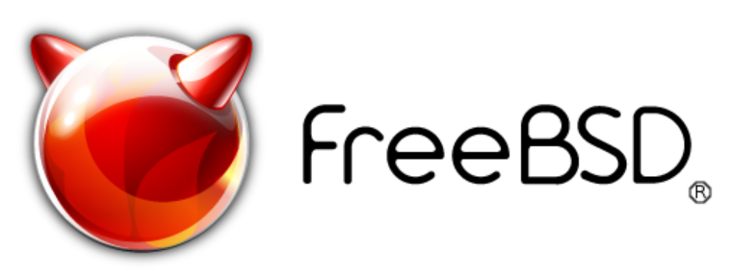
Open + Flexible
Management
Applications
App Frameworks
Databases & Middleware
Infrastructure
Linux

Slide 8





Dev + IT productivity
Visual Studio
GitHub
Eclipse
Chef + Puppet
Powershell

Slide 9
Virtual Machines
Getting started
Select image and VM size
New disk persisted in storage
Management portal
Windows Server
Boot VM from new disk
>_
Linux
Scripting
(Windows, Linux and Mac)
Blob Storage
General Purpose
Basic
Standard
Optimized Compute
Performance Optimized
Network Optimized
REST API
Cloud
Comprehensive
Networking

Slide 10
Demo: Azure Portal
Notes:
Open my portal.
Show app
And Web page?
Should addins.

Slide 11
Host your applications on Azure
The three ways to host your applications on the Microsoft Azure Platform
Infrastructure as a Service
IaaS
Platform as a Service
PaaS
Notes:
Making the point that Virtual Machines is IaaS while both CloudServices and Websites are PaaS.

Slide 12
Your service
Notes:
Slide Objectives:
Explain how Azure helps developers to refocus on their applications.
Speaker Notes:
Before we discuss about specifics, let’s refocus on what you care about – your application/service.
Azure is taking a application-centric approach and brings tools and services to support DevOps scenarios.

Slide 13
→ Your application code
→ Your infrastructure code
→ Required resources
Notes:
Slide Objectives:
Explain application is made up by application code and infrastructure code.
Speaker Notes:
Let’s start with something that you know inside-and-out: your application code. [click]
Then, for whatever reason, you decide to deploy your application to Azure. [click]
What you do is to allocate a bunch of related resources out of the humongous resource pool provided by Azure, deploy your application code to these resources, and you have a running service. [click]
For DevOps’ perspective, you need a way to reliable capture and apply your requirements on resources, which can be referred as infrastructure code.

Slide 14
Automation
Innovation
Reduced cycle time
Elasticity
Versioning environments
Continuous Deployment
Speed to market
Feedback loop
Agility
Continuous
Improvements
QoS
Availability
Insights
Growth
TCO
Notes:
Slide Objectives:
Reiterate the point that to make your service successful, you are partnering with Azure. You bring the code, and Azure brings resources.
This slide also sets state for the talk by explaining how IaaS components fit into the overall picture.
Speaker Notes:
[Continue with previous slide]
To make your service successful, you are partnering with Azure. You bring the code, and Azure brings resources. [Click] And you keep iterating and making improvements over time. [Click]
Once this partnership is going, a lot of good things follow. For instance, you get automated deployment, versioned environments, and eventually continuous deployment. [Click]
You’ll have shorted cycle time, faster feedback loops, and faster speed to market. [Click]
This also frees up your energy to gain additional business insights, to innovate, and to continuously improve your business.
And as your business is settled on cloud, you can leverage cloud to improve quality of service (QoS), to reduce total cost of ownership (TCO), and elasticity to allow Azure adapts to your business growth.

Slide 15
You: Code (application, infrastructure)
Azure: Resources (IaaS, PaaS, SaaS)
Notes:
Slide Objectives:
Reiterate the point that to make your service successful, you are partnering with Azure. You bring the code, and Azure brings resources.
Speaker Notes:
In terms of infrastructure code, you can use it to define desired states of required resources (Note: current Azure Resource Manager only support a small number of Resource Providers). [Click]
You can define hosting environments, such as websites, cloud services and VMs. [Click]
Required services. [Click]

Slide 16
Demo: Deploying a Website to Azure
Notes:
Demo: Deploying a ASP.NET Website to Azure
Prerequisites:
An active Azure subscription.
The firework application (Cache-Redis-Firework-SignalR) has been loaded in Visual Studio. Compiled and verified to work locally.
Steps:
Open Ibiza portal and click the NEW button at the lower-left corner.
Select Website and provision a new website.
Run the firework application locally. Explain this is a regular ASP.Net application (your application code) that you want to deploy to Azure.
In Solution Explorer, right-click the web project and select Publish.
Follow the publish wizard to publish the application to the website we just provisioned.
Test the application. Invite audience to participate if possible.
Switch back to slide to explain what just happened.

Slide 17
What just happened?
Notes:
Slide Objectives:
Explain what happened during demo, and pave the discussion of Resource Manager.
Speaker Notes:
You provided code. [Click]
Azure provided resource (website). [Click]
Your code is deployed to the resource and you have a running site.
Transition:
Of course here we just went through a simple scenario. A more complex system would probably require a group of resources. Introducing Azure Resource Manager that provides an extensible architecture for managing resources on Azure.

Slide 18
Cloud Services

Slide 19
Cloud Services
→ Focus on your application
→ Scalability, availability and reliability
→ Monitoring and diagnostics
Notes:
Slide Objectives:
Explain the agenda of the session.
Speaker Notes:
Explain this presentation is a high-level overview, so not everything is covered in-depth.

Slide 20
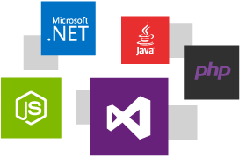
Integrated development experience powered by Visual Studio + Azure SDK
Development experience using the Azure SDK, integrated seamlessly with Visual Studio.
Deploy using any language you like, including .NET, Java, Node.js, PHP, Python, or Ruby.
Test your application before deploying to the cloud using the Azure Emulator, which brings the platform’s key functionality right to your dev machine.

Slide 21
Design for Cloud

Slide 22
A different mindset
→ Embracing errors
→ Design for availability, reliability, scalability
→ Performance
Notes:
Slide Objectives:
Explain the agenda of the session.
Speaker Notes:
Explain this presentation is a high-level overview, so not everything is covered in-depth.

Slide 23
Sample architecture
WAAD
Service Bus
Paired NS
SQL Database
US West
Data Sync
Worker Role/VM
User
Internet
Traffic Manager
US East
Worker Role/VM
NoSQL DB
Geo-redundancy
CDN
Cache

Slide 24
Redundancy in Microsoft Azure
Storage Redundancy Options
SQL Database Geo-Replication
Caching with high availability option
Load-balanced App Service Apps, Cloud Service and Virtual Machines
Built-in redundancy in Azure Virtual Network gateways
Failover with Azure Traffic Manager
Notes:
Speaker notes:
Explain one or more following options for Microsoft Azure Storage redundancy: LRS, GRS and RA-GRS.
Explain how Standard and Active Geo-Replication implements a mechanism to provide Azure SQL database redundancy.
Explain various cache services available in Microsoft Azure; High availability option In-Role Cache available in Cloud Service. Redis Cache is also available as a high availability standalone cache service if you choose the standard cache offering SKU which has a 99.9% SLA. Managed Cache is not recommended.
Explain how high availability is achieved through automatic load-balanced multi-instance App Service applications, Cloud Service and Virtual Machines.

Slide 25
Resiliency in Microsoft Azure
Auto recovery – Service Healing
Fault domain - prevent single point of failure
Virtual machine Availability set – fault domain and rolling host updates
Upgrade domain - service availability during upgrade
Deployment Slots and VIP swap
Emulator, Intellitrace and enhanced diagnostics
Telemetry - native and 3rd party support
Handle transient errors with Application Block
Notes:
Speaker notes:
Explain how Fabric Controller(FC) initiates auto recovery of crashed or nonresponsive instances; The FC monitors role instances, virtual and physical machines and initiates recovery action if any one of them deemed unhealthy. A Recovery action includes restarting a role instance, recycling a virtual machine or performing reboot of a physical machine. Virtual machines running in a defective physical machine are recovered to another healthy server.
Explain HA through fault domain to scatter instances across racks.
Explain HA through availability sets; putting two or more VMs in availability sets guarantees that your VMs are spread across multiple racks in the Windows Azure Data Centers for redundancy and hence making your service highly available. Without availability sets the FC would have no idea that two or machines are serving the same service and could reasonably take them down at the same time for host OS updates.
Explain how upgrade domain helps continued service availability during application upgrade. Upgrade domain avoids shutting down all instances at the same time during an upgrade.
Explain how Web App Deployment Slots and Cloud Service VIP swap allow promoting staging to production and manage dev/test environments with DevOps mindset. If the changes swapped into the production slot are not as you expected, you can perform the same swap immediately to get your "last known good site" back.
Explain first party and third party support for telemetry.
Explain how to make your application resilient by adding robust transient fault handling logic using the Transient Fault Handling Application block in your code.

Slide 26
What does failsafe mean for my applications?
It depends… but some general practices apply.
Take advantage of Microsoft Azure features
Avoid single point of failure
Failure mode analysis
Transient errors
Graceful degradation
Eliminate human factors
Notes:
[click]
It depends, but…. [click]

Slide 27
Scaling in Microsoft Azure
Scale up by choosing different VM sizes
Scale out by adding more instances
Auto-scale with Autoscaling Application Block
Scale out by using multiple service entities
CDN to distribute user traffic
Caching to offset server workloads

Slide 28
Azure IaaS

Slide 29
Virtual Machines

Slide 30
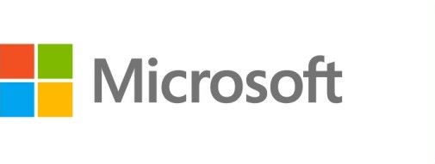



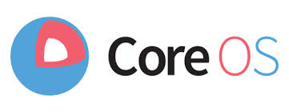

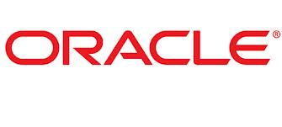
Azure Virtual Machines
Launch Windows Server and Linux in minutes
Scale from 1 to 1000s of VM Instances
Save money with per-minute billing
Open and extensible
Notes:
Slide Objectives:
High-level selling points of virtual machines.
Speaker Notes:
Both Linux and Windows are supported. It’s important to reiterate on this as many developers are still not aware of this.
Mention scaling at enterprise level using DSC, Puppet or Chef.
Emphasize on the openness – we are not forcing your to lock on Microsoft technologies. Instead, Azure is more open than ever. You can leverage your existing skills, tools and services, and Azure is providing more and more first-class supports for them.

Slide 31


Provisioning VM
Getting Started
Select Image and VM Size
New Disk Persisted in Storage
Windows Server
Management Portal
Boot VM from New Disk
Linux
>_
General Purpose
Basic
Standard
Optimized Compute
Performance Optimized
Network Optimized
Scripting
(Windows, Linux and Mac)
Cloud
REST API
Notes:
Slide Objective:
Explain workflow for provisioning VMs in the cloud
Speaker Notes:
You have three methods of starting this process: Build a VM from the portal, from the command line OR programmatically calling the REST API.
Once your choice of provisioning is made you will need to select the image and instance size to start from.
The newly created disk will be stored in blob storage and your machine will boot.

Slide 32






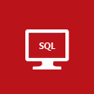


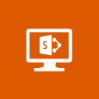







VM Gallery
A collection of prebuilt images for various workloads
Windows Server 2012 R2
Ubuntu Server 14.04 LTS
CentOS 6.5
SUSE Linux
Enterprise Server
openSUSE 13.1
Oracle Linux 6.4.0.0.0
SQL Server 2014 Standard
Oracle Database 11g R2
SharePoint Server Farm
Microsoft Dynamics
GP 2013
Zulu 8
BizTalk Server 2013
SAP HANA
Developer Edition
Puppet Enterprise 3.2.3
Barracuda Web Application
Oracle WebLogic
Server 12.1.2
Visual Studio Ultimate 2013
Windows 8.1 Enterprise
Notes:
Slide Objective:
Explain a wide variety of images that you can choose from.
Speaker Notes:
First of all, you can choose from different Windows Servers and a variety of Linux implementations. [Click]
As well as pre-built images for different flavors of SQL Database and Oracle databases. [Click]
You can also choose from a number of first-party and certified third-party images for various application servers and infrastructural components. [Click]
And last but not least, if you are a MSDN subscriber, you also have access to Visual Studio images and client Windows systems such as Windows 7 and Windows 8.1 for your DevTest purposes.

Slide 33
Virtual Machine Sizess
General Purpose compute: Basic
General Purpose compute: Standard
Optimized Compute
Performance Optimized
Network Optimized
Notes:
Slide Objective:
Introduce different virtual machine sizes.
Speaker Notes:
http://azure.microsoft.com/en-us/pricing/details/virtual-machines/

Slide 34
Scale-up options
Highest value
Largest scale-up
A
D
G
N
DV2
Highest value
Most memory fastest CPUs
GPU-enabled virtual machines
SSD Storage Fast CPUs
>80,000 IOPs
Premium Storage
New generation of D family VMs
35% faster than D
Intel E5-2673 v3 CPUs
NVIDIA GPUs
Remote visualization
Compute-intensive + RDMA
Largest virtual machines Fastest storage in the public cloud

Slide 35
VMs + Containers

Slide 36
Containers
App
A
App
A
App
B
What are they?
Unit of deployment
Isolated environment
Isolated collection of resources
What are the benefits?
Instant startup
Repeatable and reliable execution
Scenarios
Dev/Test
Great for micro-services
App
Framework
App
Framework
App
Framework
VM
Host OS
Guest OS
Guest OS
Guest OS
Hypervisor
Physical Server
App
A
App
A
App
B
App
B
App
B
Container
Container Manager
App
Framework
App
Framework
Host OS
Physical Server
Notes:
When you see “containers” you probably think of Docker. For good reason, Docker has essentially defined the container market. To understand what Docker is let’s start by looking at Containers.
Containers are an isolated environment and isolated collection of resources that an application runs in. The resources are all the dependencies (DLL’s, configuration, etc.) that the application needs. Everything the application needs to run is in the container and it sees nothing on the host OS it is running on (except maybe an internet connection). Containers are therefore a unit of deployment.
<click>
A key benefit of containers is that they can startup almost instantly. The notion of “booting up” a guest OS doesn’t exist. The container just runs on top of the host OS. As a result, containers can startup almost instantly as compared to the startup period of a VM. And because everything is contained in this container, containers are easily repeatable and extremely reliable from one environment to the next. For example, I can run a container on my local dev box and have high confidence it will run the same when deployed to another machine, such as a VM running in Azure.
<Click>
As you can probably imagine, containers are extremely popular in dev/test scenarios. They are also great for micro-services.
<click>
To put a visual behind this, consider the architecture for a typical virtual machine. You have a physical server, hyper-visor and host OS. Then, each VM has it’s own guest OS that can be configured with applications and application frameworks. This is what you saw earlier in the presentation.
<click>
Now consider how a container is different. Physical Server with a host OS. However, notice there is not a guest OS. The container is essentially the application and it’s dependencies. Also notice that the app frameworks used by application A and application B are shared in this model. This is how instant startup is achieved.
Note that there are more instances of the same App running on the physical server. This underlines that a container is a scale unit besides being an isolation mechanism. In a production development you would use a cluster of hosts, and have containers spread of the hosts.

Slide 37
Image Mobility
On-Premises
Cloud
MyApp.vhd
Notes:
Slide Objective:
Explain the benefits of image mobility
Notes:
One of the key benefits of IaaS is flexibility and control. The Microsoft Azure solution provides the capability of not only moving VHDs TO the cloud but also allows you to copy the VHD back down and run it locally or on another cloud provider. Great for testing out production issues or any other need where you require a copy of the production server.

Slide 38
Data Persistence
OS Disks
Data Disks

Slide 39
Disks and Images
OS Images
Microsoft
Partner
User
Base OS image for new Virtual Machines
Sys-Prepped/Generalized/Read Only
Created by uploading or by capture
Disks
OS Disks
Data Disks
Writable Disks for Virtual Machines
Created during VM creation or during upload of existing VHDs.
Notes:
Slide Objective:
Explain the differences between disks and images with VMs

Slide 40
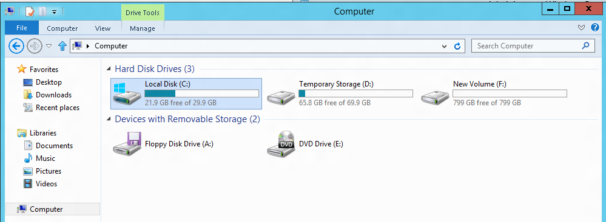
VM disk layout
OS Disk
Persistent
SATA
Drive C:
Temporary Storage Disk
Local (Not Persistent)
SATA
Drive D:
Data Disk(s)
Persistent
SCSI
Customer Defined Letter

Slide 41
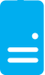
Persistent Disks and Highly Durable
Microsoft Azure Storage (Disaster Recovery)
Microsoft Azure Storage
Virtual
Machine
Virtual Machine
Notes:
Slide Objective:
Explain how disks are durable and how Microsoft Azure storage works
Notes:
The OS and Data Disks are stored in Microsoft Azure storage. So in addition to the data being persistent you also get the benefits of storage which means your VHD is replicated 3X’s locally and also 3X’s in a separate data center in the same region (geo-replication)

Slide 42
Load balancing
Load balancing
Multiple VMs share the workload via public facing endpoints
Internal Load balancing
Load balancing between VMs that don’t have public facing endpoints
Microsoft Azure
Internet
Public VIP
Customer vNet
External Load Balancer
Internal Load Balancer
Microsoft Azure
Back end
Front end

Slide 43
Traffic Manager
Load balancing
Failover
US West
North Europe
Microsoft Azure
North America
Europe

Slide 44

Transform the datacenter Orchestrated disaster recovery to a second site
Microsoft Azure Hyper-V Recovery Manager
Communication Channel
Replication channel: Hyper-V Replica
Windows Server
Primary Site
Recovery Site
Windows Server

Slide 45
Transform the datacenter Orchestrated disaster recovery to a second site or to Azure
Microsoft Azure Site Recovery
Microsoft Azure Site Recovery
Communication Channel
Communication and Replication
Replication channel: Hyper-V Replica
Windows Server
Primary Site
Recovery Site
Windows Server
Primary Site
Windows Server
Key features include:
Automated VM protection and replication
Remote health monitoring
Customizable recovery plans
No-impact recovery plan testing
Orchestrated recovery when needed
Notes:
Speaker Note:
Consider this demo if time permits:
https://microsoft-my.sharepoint.com/personal/mmcspirt_microsoft_com/Documents/Shared%20with%20Everyone/BCDR
The specific demo is Azure Site Recovery – Between Sites.exe

Slide 46


Microsoft Azure Key Vault
Key Vault offers an easy, cost-effective way to safeguard keys and other secrets used by cloud apps and services using HSMs.
You manage your keys and secrets
Applications get high performance access to your keys and secrets… on your terms
Microsoft Azure
IaaS
PaaS
SaaS
Key Vault
Import keys
HSM
Notes:
Azure Key Vault offers an easy, cost-effective way to safeguard keys and other secrets used by cloud apps and services. With Key Vault, customers can streamline key management and maintain control of keys used to access and encrypt their data.

Slide 47
Enhance data protection and compliance
Increased security
HSM protected keys
Compliance
Monitoring
Encrypt keys and small secrets like passwords using keys protected by tightly controlled and monitored Hardware Security Modules (HSMs)
Import or generate your keys in HSMs for added assurance – so that keys stay within the HSM boundary
Comply with regulatory standards for secure key management, including the US Government FIPS 140-2 Level 2 and Common Criteria EAL 4+
Monitor and audit key use through Azure logging – pipe logs into HDInsight or your SIEM for additional analysis (coming soon)
Notes:
Enhance data protection and compliance
Encrypt keys and small secrets like passwords using keys stored in tightly controlled and monitored Hardware Security Modules (HSMs)
Import or generate your keys in HSMs for added assurance. Key Vault is designed so that keys stay within the HSM boundary
Comply with regulatory standards for secure key management, including the US Government FIPS 140-2 and Common Criteria EAL 4+
Monitor and audit key use through Azure logging – pipe logs into HDInsight or your SIEM for additional analysis (coming soon)

Slide 48
Azure Resource Manager

Slide 49
Azure Resource Manager & Resource Groups
Manage resources as a single unit
Role based access and control (RBAC) on groups or resources
Billing integrated tagging on groups or resources
RESOU
R
CE G
R
OUP

Slide 50
Azure Data Overview

Slide 51
Agenda
SQL Database
SQL Server VM
DocumentDB
Search
HDInsight
Additional Databases
Notes:
The Azure data Platform is HUGE and growing. This session will have to be brief about some of this content and make a few deep dives here and there.

Slide 52
SQL Database
Notes:
Now let’s focus on Microsoft Azure SQL Database the PaaS service!

Slide 53

Microsoft Relational Storage Options
A Continuous offering
Physical
Virtual
IaaS
PaaS
From private to public Cloud
Notes:
Slide Objectives:
Show Microsoft’ continuous Private to Public Cloud Offering, but this presentation will focus on Microsoft’s relational database PaaS offering.
Transition:
Microsoft provides a continuous solution from private cloud to the public cloud. No matter where you are on your technology roadmap we have a solution to fit your needs.
We are a trusted advisor and platform in the traditional enterprise and ISV space with new IaaS offerings that making it easier to bring this same level of trust and ease of use to the public cloud. However, Microsoft Azure SQL Database extends SQL Server capabilities to the cloud by offering SQL Server as a relational database service.
Speaking Points:
SQL Database provides SQL Server as a relational service.

Slide 54
Architecture
Starting with the basics

Slide 55
A Server is not a machine
SQL Server
Machine
(Physical/VM)
Azure
SQL Database Server
TDS Endpoint
Notes:
Slide Objectives:
Understand that while there are physical SQL Server boxes behind the scenes, when connecting to SQL Database, you are not connecting to a physical server, but to a TDS endpoint.
Transition:
The key to understanding SQL Database is understanding while SQL Database is SQL Server, we do not interact with them in the same physical manner.
Speaking Points:
In an on-premises environment, we typically have physical access to the actual SQL Server server.
In Microsoft Azure, we do not have physical access to the actual server.
Notes:
It is important that the attendee understands that it IS INDEED SQL Server at the platform layer. There are physical boxes running SQL Server 2012 Enterprise Edition. However, due to the nature of the Azure environment to provide the high-availability and scalability necessary, access to the physical boxes is currently not supported.

Slide 56
SQL Database The Basics
SQL Server database technology “as a Service”
Fully Managed
Enterprise-ready with automatic support for HA, DR, Backups, replication and more
Notes:
Slide Objectives:
Understand the overall concepts and benefits of SQL Database
Transition:
Let’s clear up any confusion and look at the basics of what SQL Database really is and some of its benefits.
Speaking Points:
The same great SQL Server database technology that you know, love, and use on-premises provided as a service
Enterprise-ready
Automatic support for High-Availability
Designed to scale on-demand to provide the same great elasticity
Notes:
High-availability – 3 copies of the database free for the cost of the one database. Always in sync. The cost to do this on-premises isn’t cheap. This is FREE in SQL Database.

Slide 57
SQL Database The Basics
Scale out with ElasticScale
Built-in regional database replicas for additional protection
Uptime SLA of 99.99%
Notes:
Slide Objectives:
Understand the overall concepts and benefits of SQL Database
Transition:
Let’s clear up any confusion and look at the basics of what SQL Database really is and some of its benefits.
Speaking Points:
The same great SQL Server database technology that you know, love, and use on-premises provided as a service
Enterprise-ready
Automatic support for High-Availability
Designed to scale on-demand to provide the same great elasticity
Notes:
High-availability – 3 copies of the database free for the cost of the one database. Always in sync. The cost to do this on-premises isn’t cheap. This is FREE in SQL Database.

Slide 58
How It Works – Architecture of the Service
Client Layer
PHP
SQL Server
Applications
and Tools
WCF Data Services
Applications communicate directly with SQL Database using TDS.
ODBC
ADO.NET
Tabular Data Stream (TDS)
Notes:
Client - The client layer resides closest to your application, and is used by your application to communicate directly with SQL Database. The client layer can reside on-premise in your datacenter or be hosted in Microsoft Azure. Because SQL Database provides the same tabular data stream (TDS) interface as SQL Server, you can use familiar tools and libraries to build client applications for data that is in the cloud.

Slide 59
How It Works – Architecture of the Service
Client Layer
PHP
SQL Server
Applications
and Tools
WCF Data Services
ODBC
ADO.NET
Tabular Data Stream (TDS)
TDS+SSL
Gateway between Client layer and Platform layer.
Services Layer
Provisioning
Billing and Metering
Connection Routing
Notes:
Services - The services layer functions as a gateway between the client layer and the platform layer, where the data resides. The services layer provides three functions: provisioning, billing and metering, and connection routing.
The services layer provisions the databases that you specify with your Microsoft Azure platform account. The billing and metering aspect of the services layer enables multi-tenant support by providing monitoring and billing for database usage based on individual Microsoft Azure platform accounts. SQL Database is built on a scalable platform involving numerous physical servers; this layer handles all the connections routing between your application and the physical servers where your data resides.

Slide 60
How It Works – Architecture of the Service
Client Layer
PHP
SQL Server
Applications
and Tools
WCF Data Services
ODBC
ADO.NET
Tabular Data Stream (TDS)
TDS+SSL
Services Layer
Provisioning
Billing and Metering
Connection Routing
Includes physical servicers and services that support the Services layer.
Platform Layer
SQL Server
SQL Database Fabric
Management Services
Notes:
Platform - The platform layer includes the physical servers and services that support the services layer. The platform layer consists of many instances of SQL Server, each of which is managed by the SQL Database fabric.
The SQL Database fabric is a distributed computing system composed of tightly integrated networks, servers, and storage. It enables automatic failover, load balancing, and automatic replication between physical servers.
Management services monitor the health of individual servers and enable automated installation of service upgrades and software patches.

Slide 61
How It Works – Architecture of the Service
Client Layer
PHP
SQL Server
Applications
and Tools
WCF Data Services
ODBC
ADO.NET
Tabular Data Stream (TDS)
TDS+SSL
Services Layer
Provisioning
Billing and Metering
Connection Routing
Platform Layer
SQL Server
SQL Database Fabric
Administration of the physical HW and OS.
Management Services
Infrastructure Layer
Notes:
Infrastructure - The infrastructure layer represents the IT administration of the physical hardware and operating systems that support the services layer.

Slide 62
How It Works – Architecture of the Service
Client Layer
PHP
SQL Server
Applications
and Tools
WCF Data Services
ODBC
ADO.NET
Tabular Data Stream (TDS)
TDS+SSL
Services Layer
Provisioning
Billing and Metering
Microsoft Azure SQL Database
PaaS
Connection Routing
Platform Layer
SQL Server
SQL Database Fabric
Management Services
Infrastructure Layer
Notes:
Slide Objectives:
To understand the actual architecture that provides the enterprise-ready SQL Database service.
Transition:
Developers have spent years working with their technology of choice, and Microsoft wanted to ensure that the technologies and tools you use today will continue to work with SQL Database without learning a whole new set of technologies.
Speaking Points:
Familiar technology and tools
Similar architecture as that of on-premises
Additional layer providing server and database partitioning, client connection routing, and billing.
Same great SQL Server technology on the backend.
Additional services (SQL Database Fabric) to ensure SLAs are met and to ensure optimum performance.

Slide 63
Available in all tiers: Basic, Standard and Premium
Built on geo-redundant Azure Storage
Recover to any Azure region
Geo-restore – Emergency data recovery when you need it most
Notes:
Emergency data recovery when you need it most
Can also duplicate to different geo regions

Slide 64
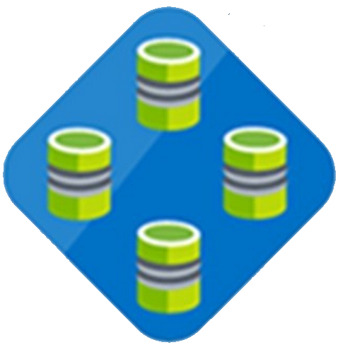
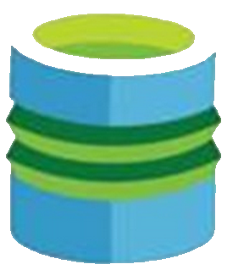

Elastic Database Pool
Elastic Database
Pool
Elastic Database
Predictable model for deploying large numbers of databases
Notes:
Speaker notes:
Elastic pools simplify the process of creating, maintaining, and managing both performance and cost for large numbers of Azure SQL databases.
Manage large numbers of databases that have unpredictable resource demands.
Ability to run centralized queries and reporting tools across database pool.

Slide 65
Why (at least) two offerings of SQL in Azure?
SQL IaaS
SQL Database

Slide 66
SQL Database
SQL IaaS
When you want reduced overhead and possibly need elastic scale.
Customer does not want to add additional IT resources for support and maintenance.
Existing applications which requires full box product functionality.
Customer has ecosystem of IT resources for support and maintenance.

Slide 67
HDInsight
Notes:
Data Analytics

Slide 68
Data Warehousing

Slide 69
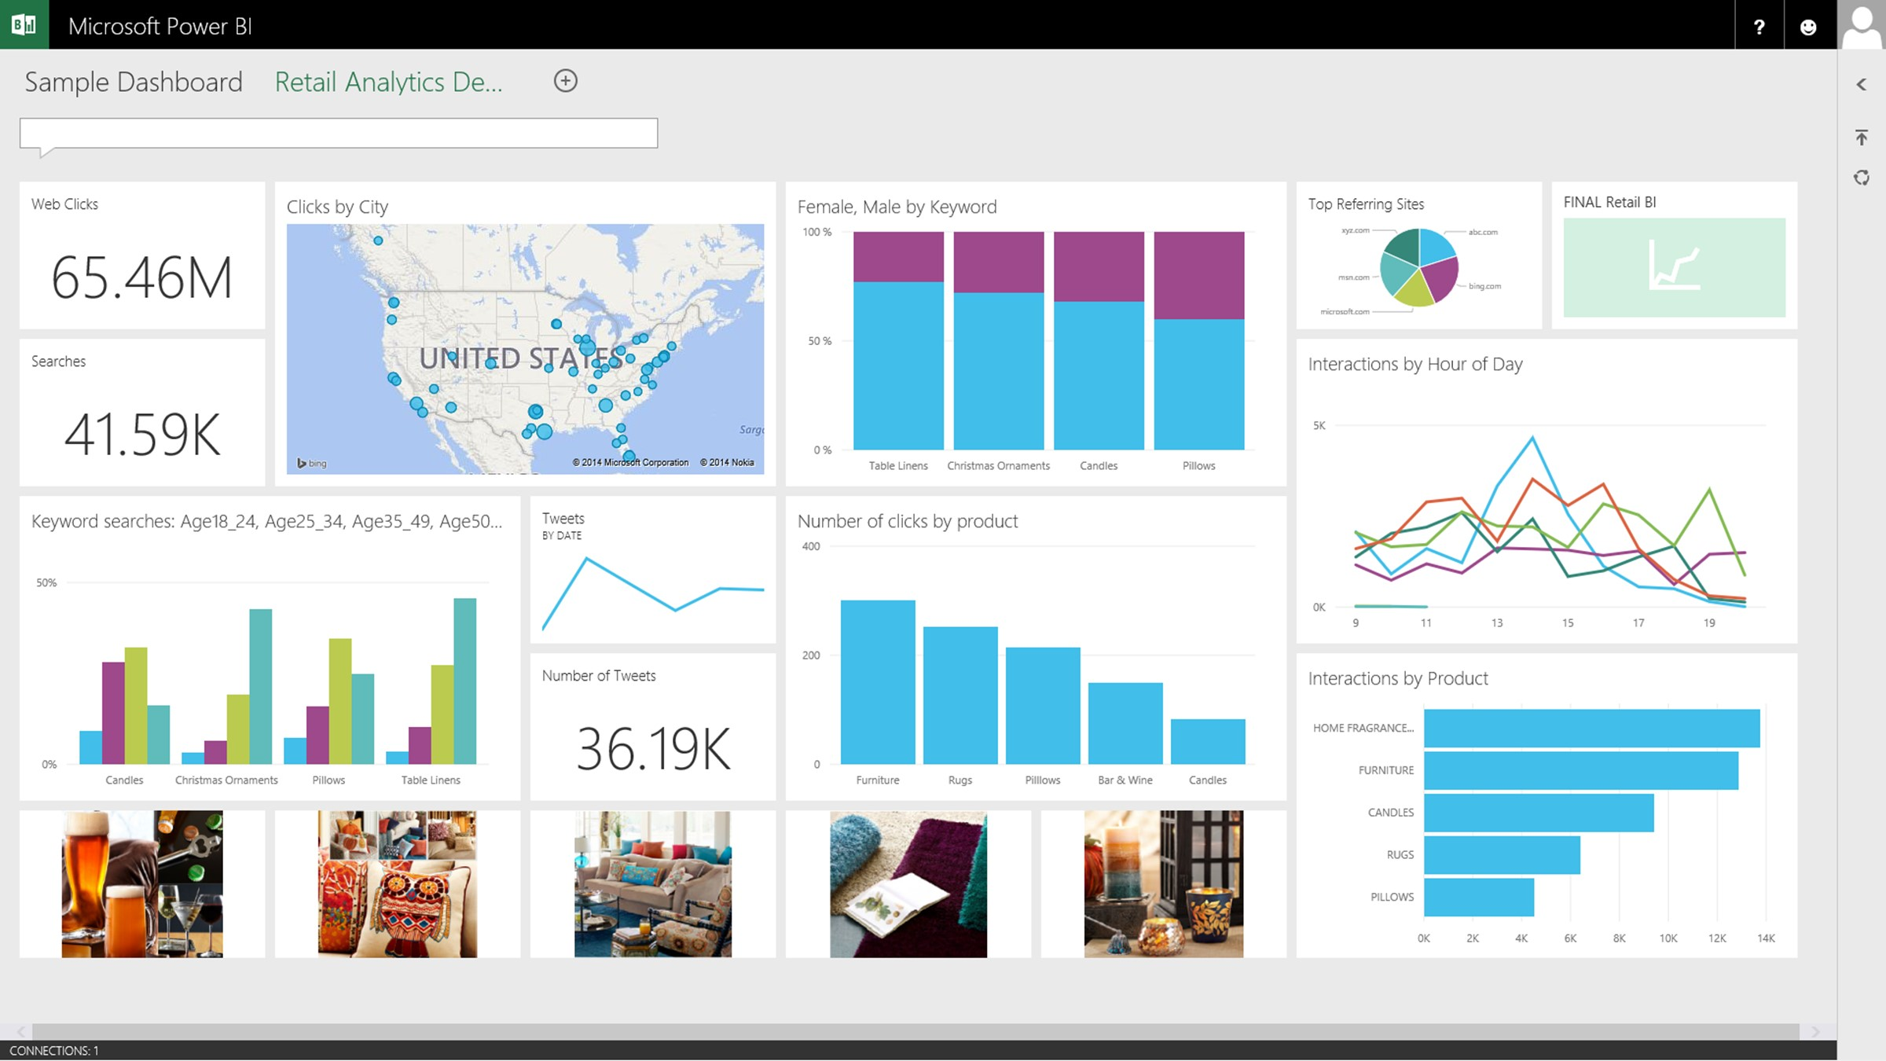

A relational data warehouse-as-a-service
Power BI
Hadoop
App Service
Azure SQL Database
Azure SQL Data Warehouse
Intelligent App
Azure Machine Learning
Notes:
Speaker notes:
Fully managed relational data warehouse-as-a-service.
Industry’s first elastic cloud data warehouse with enterprise-grade capabilities
Support your smallest to largest data sets

Slide 70
Elastic scale & performance
Powered by the Cloud
Market Leading Price & Performance
Scales to petabytes of data
Massively Parallel Processing
Instant-on compute scales in seconds
Query Relational / Non-Relational
Get started in minutes
Integrated with Azure ML, PowerBI & ADF
Enterprise Ready
Simple billing compute & storage
Pay for what you need, when you need it with dynamic pause
Bring DW to the Cloud without rewriting

